Slide 1
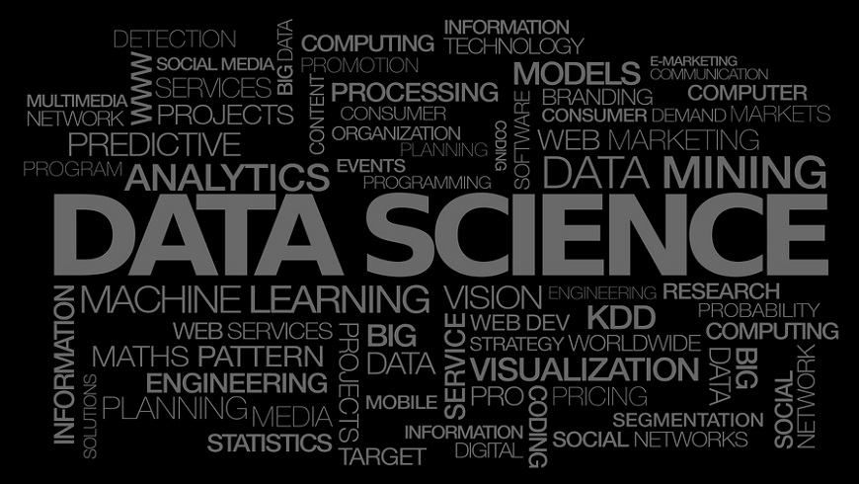
Demystifying Data Science
-Subhash Konda

Slide 2
Agenda
Introduction
What is Data Science
Where the Data is Coming from
Why do we care about Data now
Who can be data scientist
Kinds of Data
Structured
Un-Structured
Semi-Structured
Data Analytics Use Cases
Perspective
Predictive
Descriptive
Cognitive
ML-Thinking
Tools for Data Science
ML Algorithms – Types of Models

Slide 3
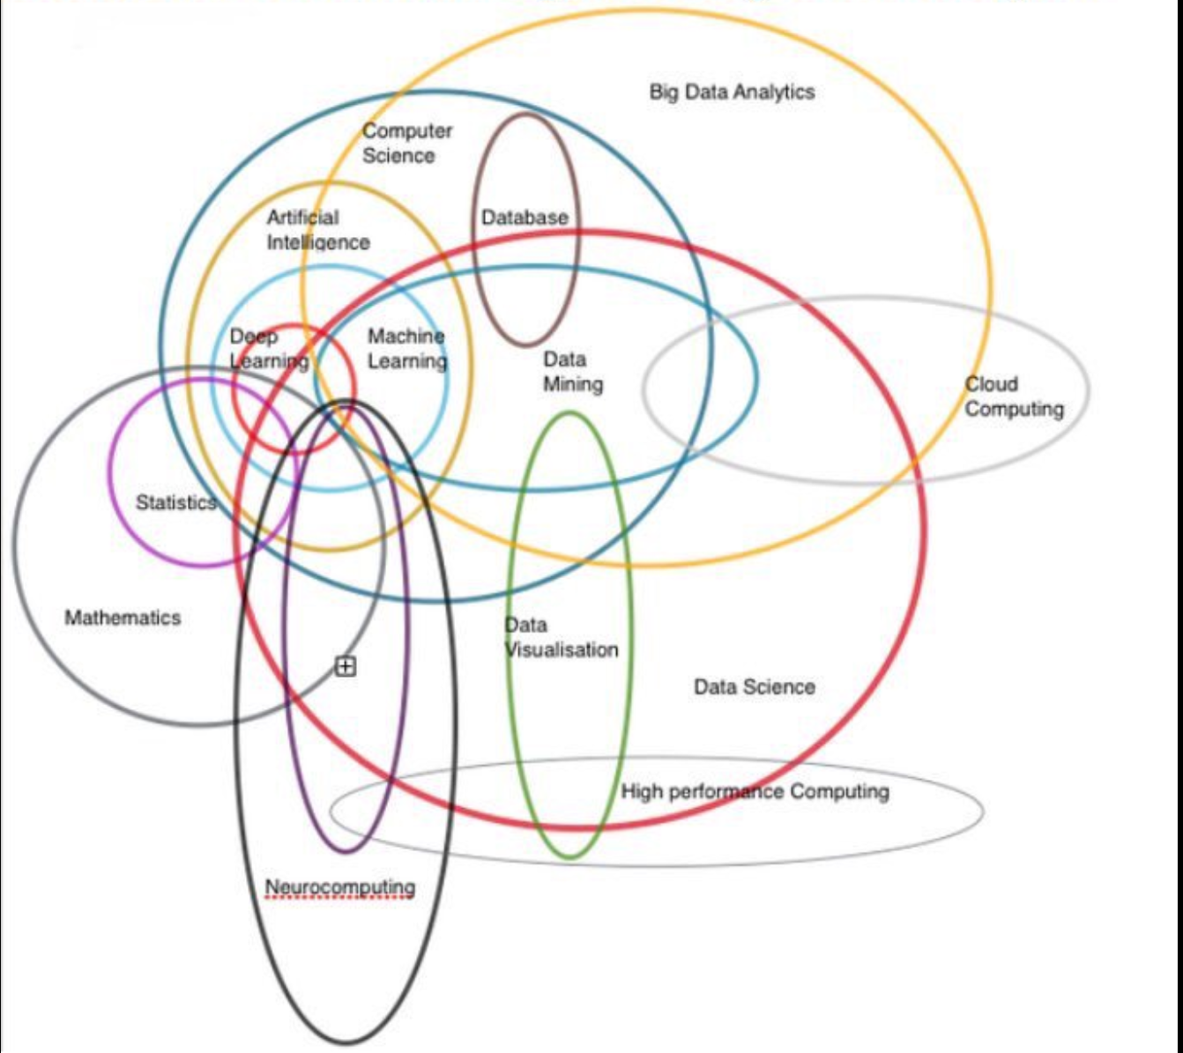
What is Data Science

Slide 4
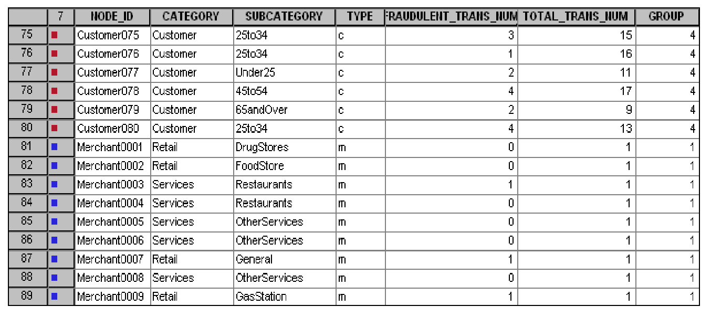
Sources of Data – Transactional Data
Customer Details
Employee Details
Products Purchased and Sold

Slide 5

Sources of Data – Social Networks Data
Posts/Tweets in Social Media
Phots and Videos
Instant and Email Messages
Voice Data

Slide 6
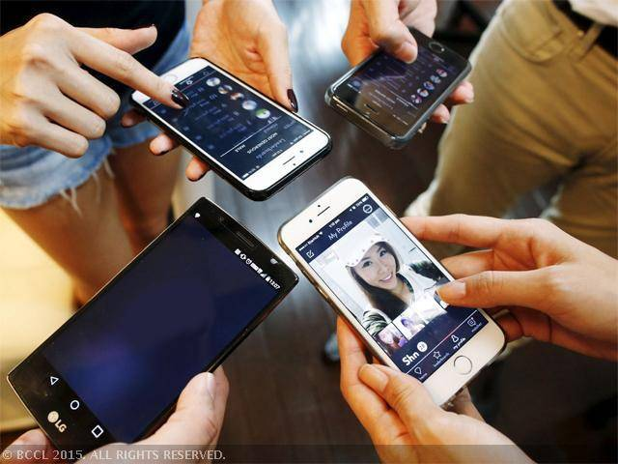
Sources of Data – Handheld Devices Data
GPS Data
Apps Data
Instant Messages
Media Data

Slide 7
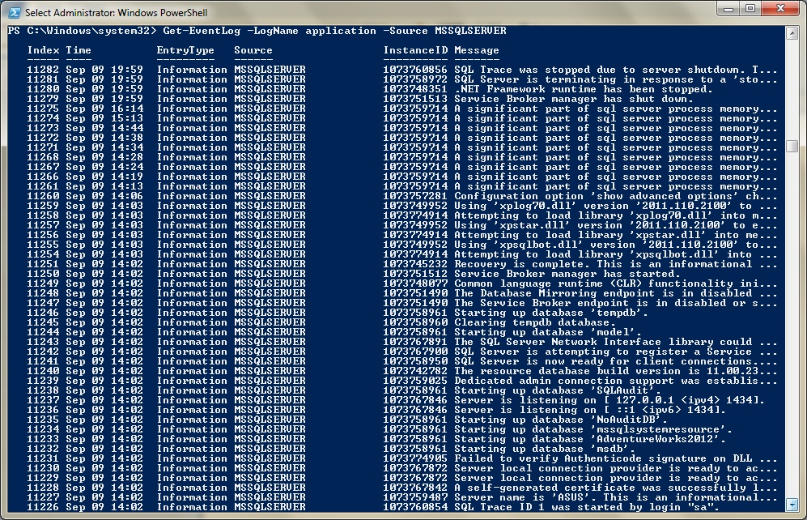
Sources of Data – Server Logs
Application logs
Audit logs
User logs
System logs

Slide 8
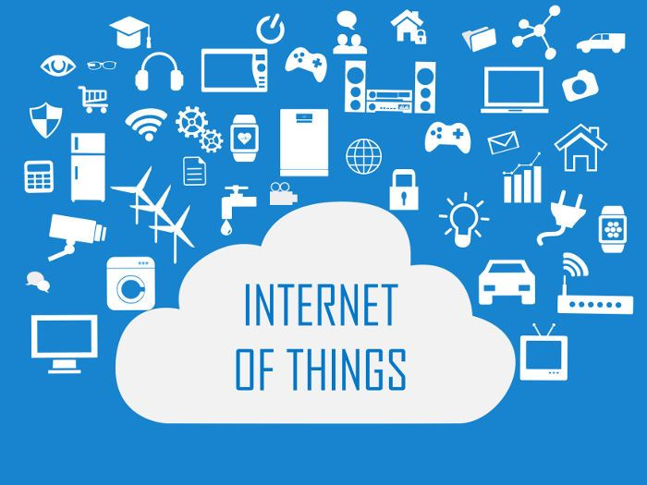
Sources of Data – IoT
Sensors Data
More than 65 billion devices were connected to the internet by 2010, and this will go up to 230 billion by 2020

Slide 9
Types of Data
Structured: Transactional Data
Semi-Structured: Log data, XML, JSON, Sensor data
Un-Structured: Images, Voice, Videos, Text (Instant messages, Emails, Blogs, Reviews …)

Slide 10
Why do we care about Data
Data has inherent value and this can’t be ignored
Insights from the data helps to make a better decisions
Insights from the data helps to make a better product
Take a competitive advantage by providing personalized services.

Slide 11
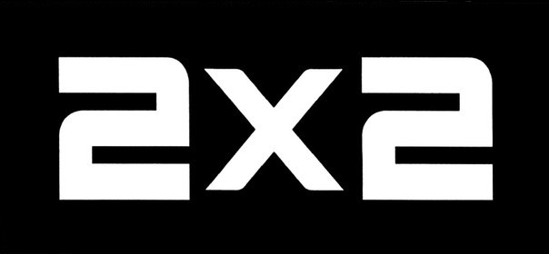

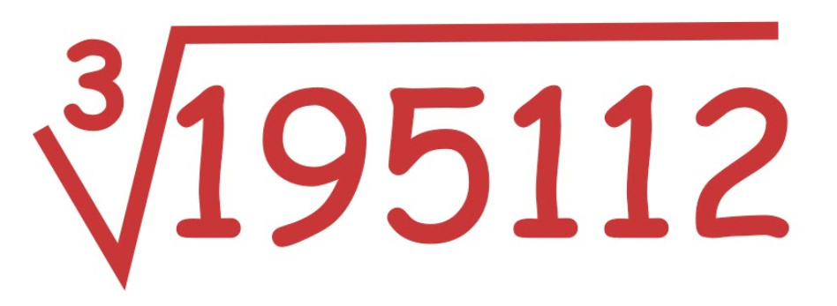



Machine Learning (AI)
Human Machine

Slide 12
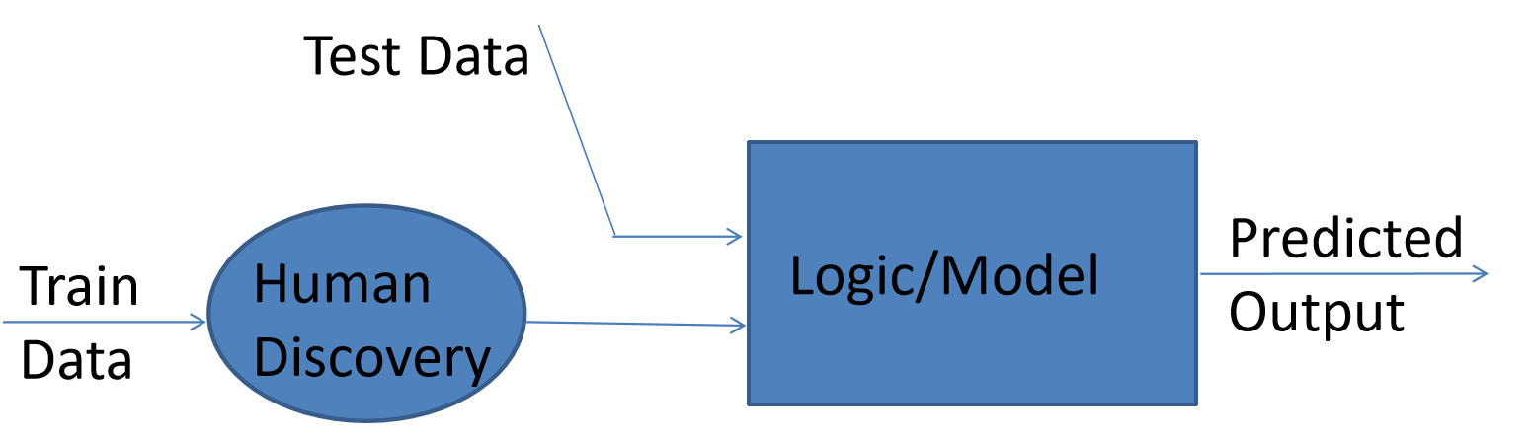
Traditional Approach: Human Discovery
Issues:
Human has to go through the data and discover the pattern/logic
If the logic is not suitable for the future data need to rediscover the logic
Is it practical to (re)discover the logic if the data is big?

Slide 13
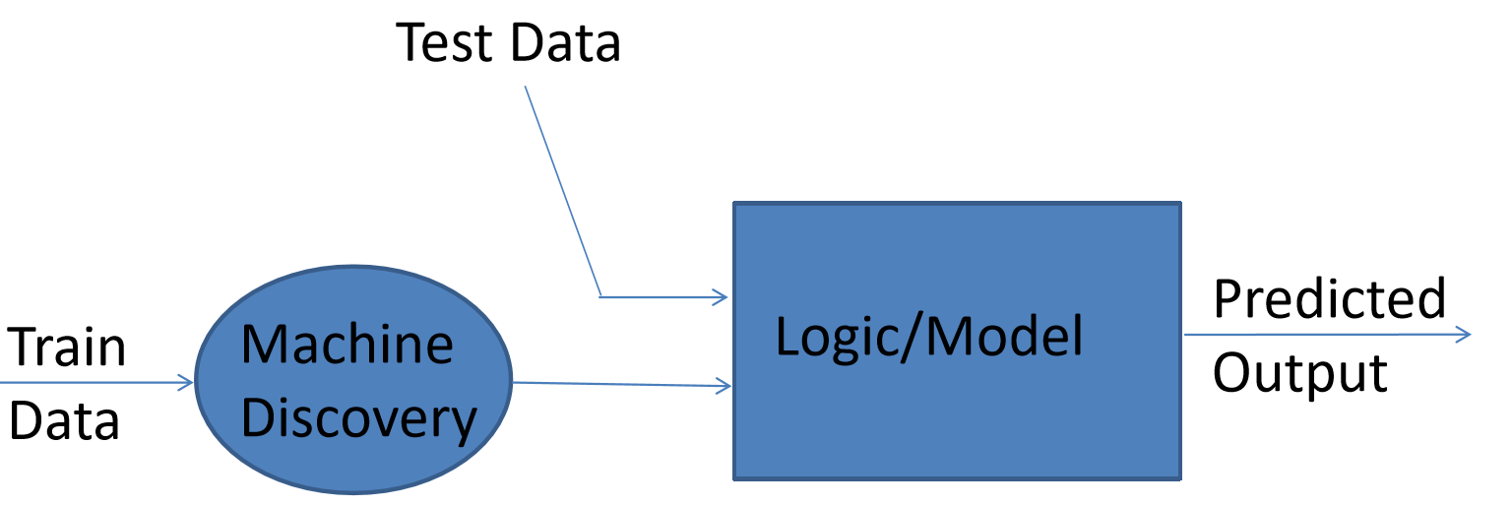
New Approach: Machine Discovery
Can Machine discover the pattern if so?
Can process the big data sets easily (with more peers)
Can rediscover the pattern if not proper
But how can a machine discover the pattern / logic?

Slide 14
New Approach: Machine Discovery
Can Machine discover the pattern if so?
Can process the big data sets easily (with more peers)
Can rediscover the pattern if not proper
But how can a machine discover the pattern / logic?

Slide 15
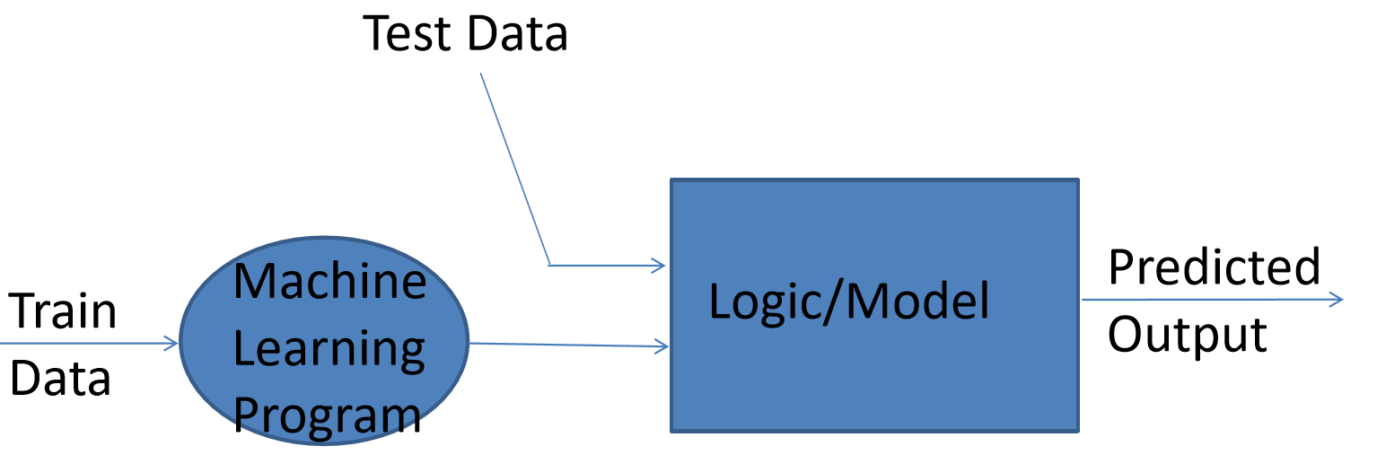
New Approach: Machine Discovery
Anything happens in machine is via program/software
Program to discover the logic – ML Programming
Different ML Algorithms discover parrters in different ways, so need to find which approach is best for the given problem/data

Slide 16
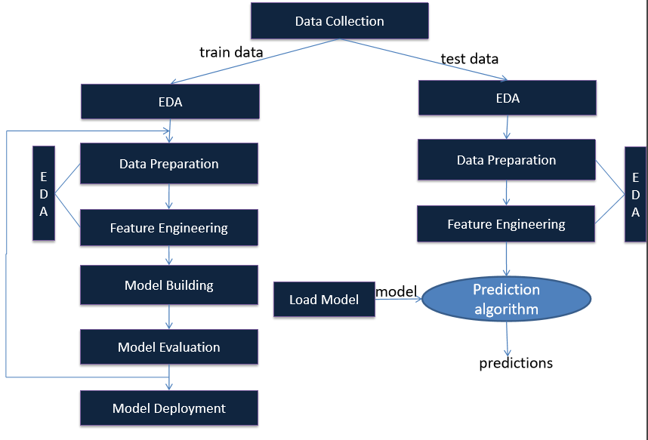
(Big) Data Analytics Lifecycle

Slide 17
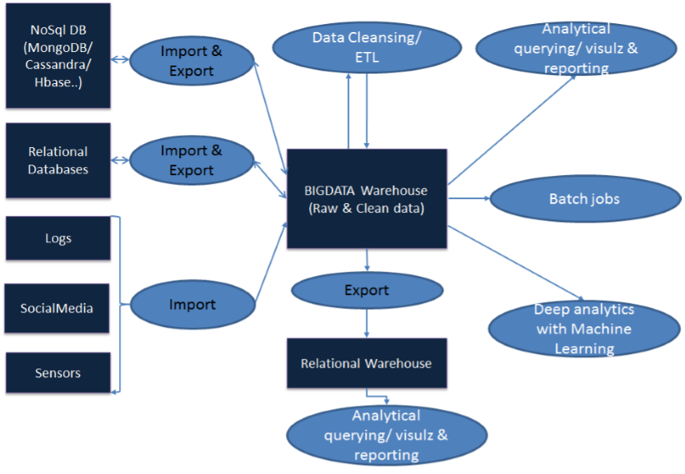
(Big) Data Analytics : Uber picture

Slide 18
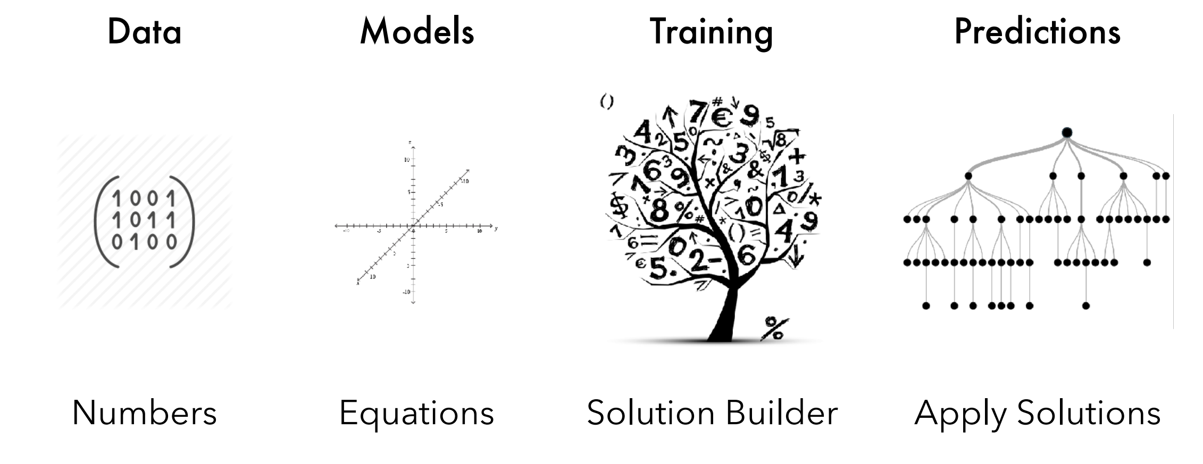
ML - Thinking

Slide 19
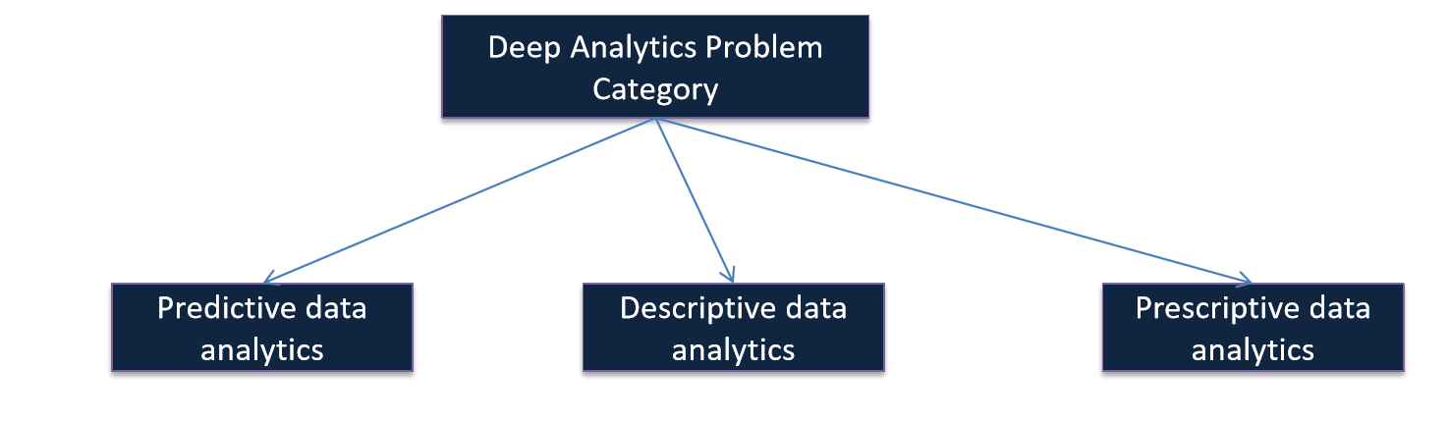
Data Analytics Use Cases
· Descriptive Analytics, which use data aggregation and data mining to provide insight into the past and answer: “What has happened?”
· Predictive Analytics, which use statistical models and forecasts techniques to understand the future and answer: “What could happen?”
· Prescriptive Analytics, which use optimization and simulation algorithms to advice on possible outcomes and answer: “What should we do?”

Slide 20
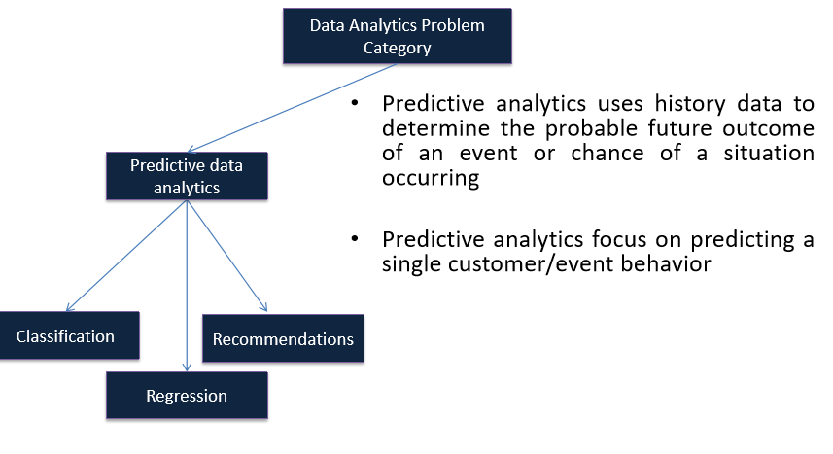
Predictive Data Analytics

Slide 21
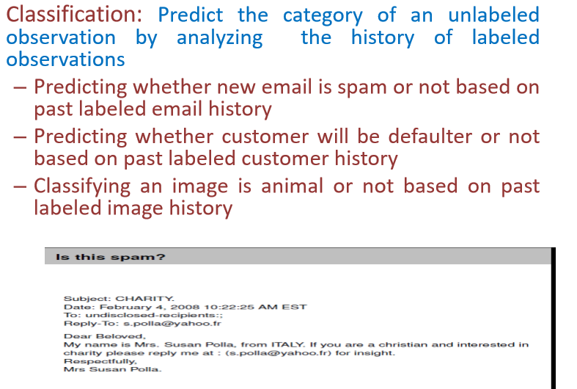
Predictive Data Analytics : Classification

Slide 22
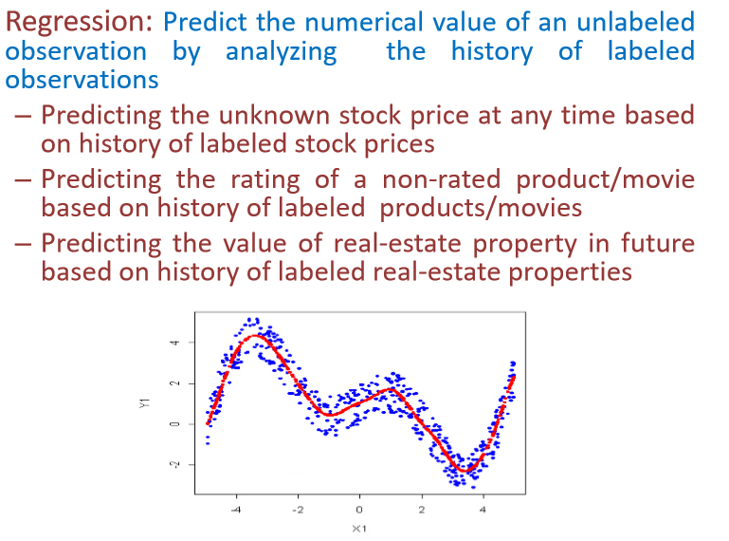
Predictive Data Analytics : Regression

Slide 23
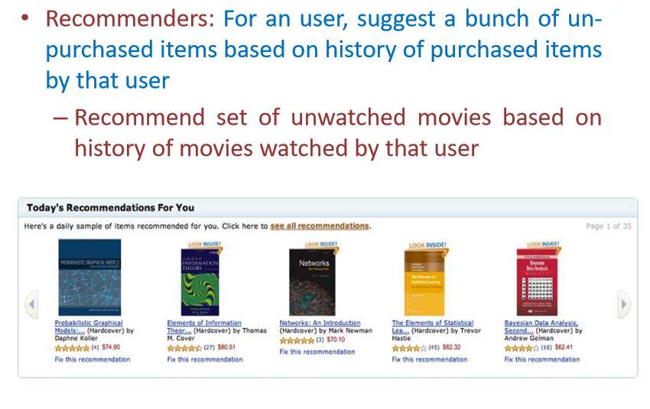
Predictive Data Analytics: Recommendations

Slide 24
Predictive Data Analytics: Recommendations

Slide 25
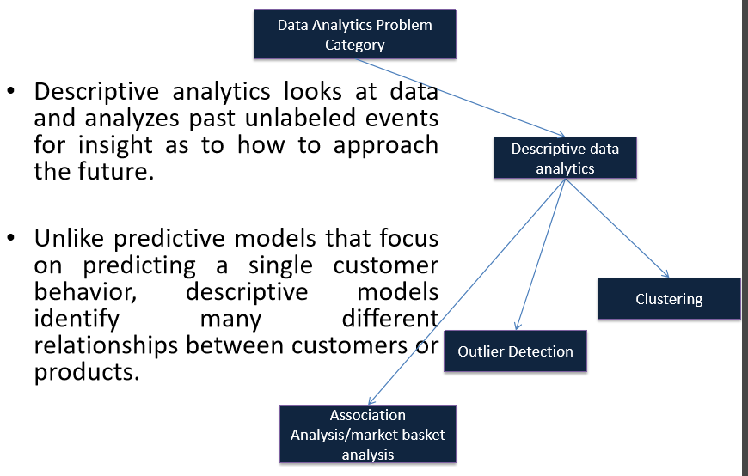
Descriptive Data Analytics

Slide 26
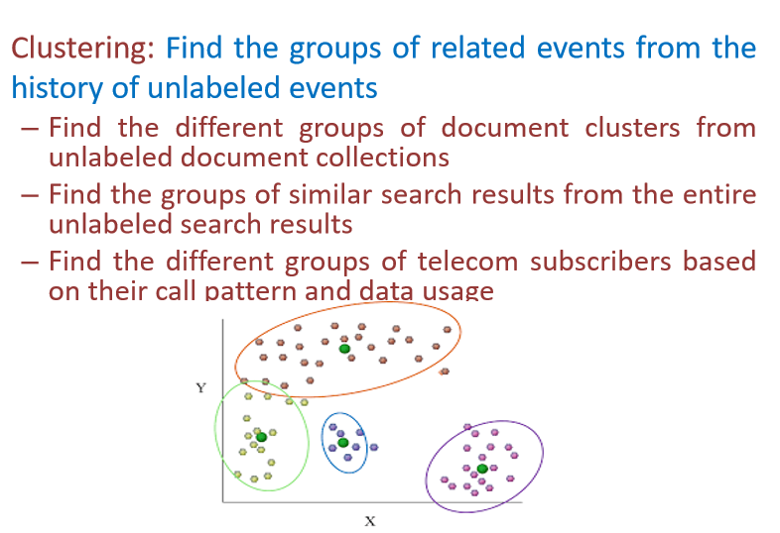
Descriptive Data Analytics: Clustering

Slide 27
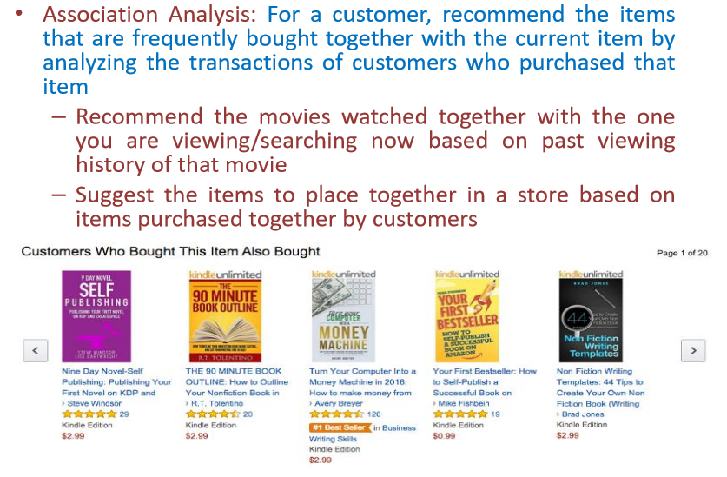
Descriptive Data Analytics: Associations

Slide 28
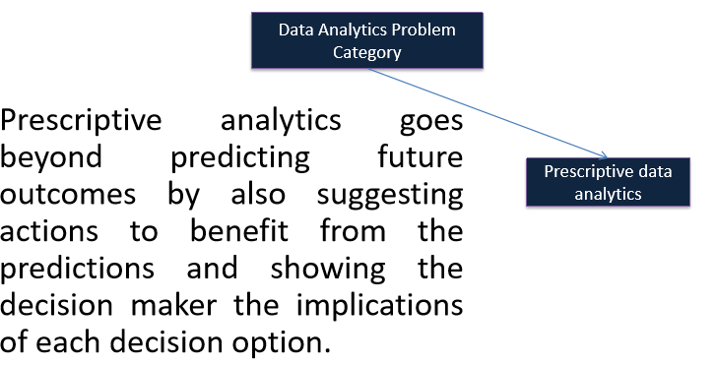
Prescriptive Data Analytics

Slide 29
Tools/Technologies

Slide 30
ML algorithms Cheat Sheet

Slide 31
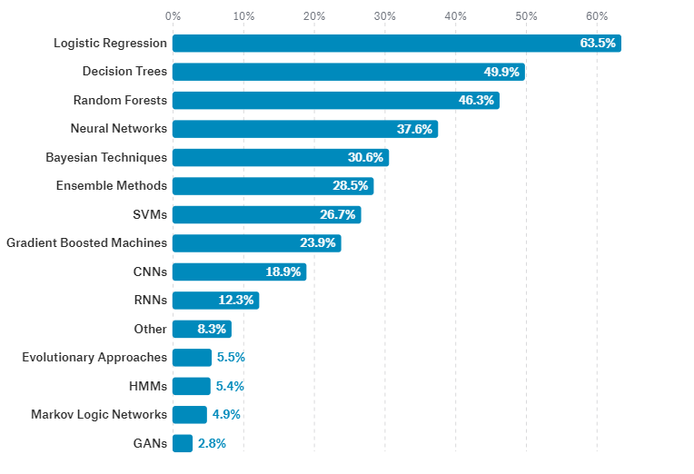
ML Models Usage

Slide 32



